Slide 1


Slide 2
Parallel computers are those systems that emphasize parallel processing.
We divide parallel computers into three architectural configurations:
Pipeline computers
Array processors
Multiprocessors

Slide 3
In a pipelined computer successive instructions are executed in an overlapped fashion.
In a non pipelined computer these four steps must be completed before the next instructions can be issued.
An array processor is a synchronous parallel computer with multiple arithmetic logic units called processing elements (PE) that can operate in parallel in lock step fashion.
By replication one can achieve spatial parallelism.
The PEs is synchronized to perform the same function at the same time.
A basic multiprocessor contains two or more processors of comparable capabilities.
All processors share access to common sets of memory modules, I/O channels and peripheral devices.

Slide 4
1. Pipeline computers
The process of executing an instruction in a digital computer involves 4 major steps
  Instruction fetch
  Instruction decoding
  Operand fetch
  Execution
In a pipelined computer successive instructions are executed in an overlapped fashion.
In a non pipelined computer these four steps must be completed before the next instructions can be issued.

Slide 5
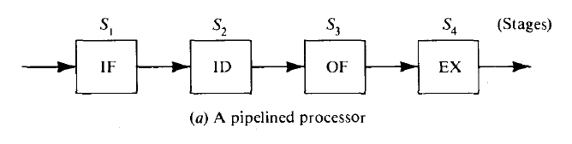
Instruction fetch : Instruction is fetched from the main memory
Instruction decoding: Identifying the operation to be performed.
Operand Fetch: If any operands is needed is fetched.
Execution : Execution of the Arithmetic and logical operation
The operations of all stages are triggered by a common clock of the pipeline.

Slide 6
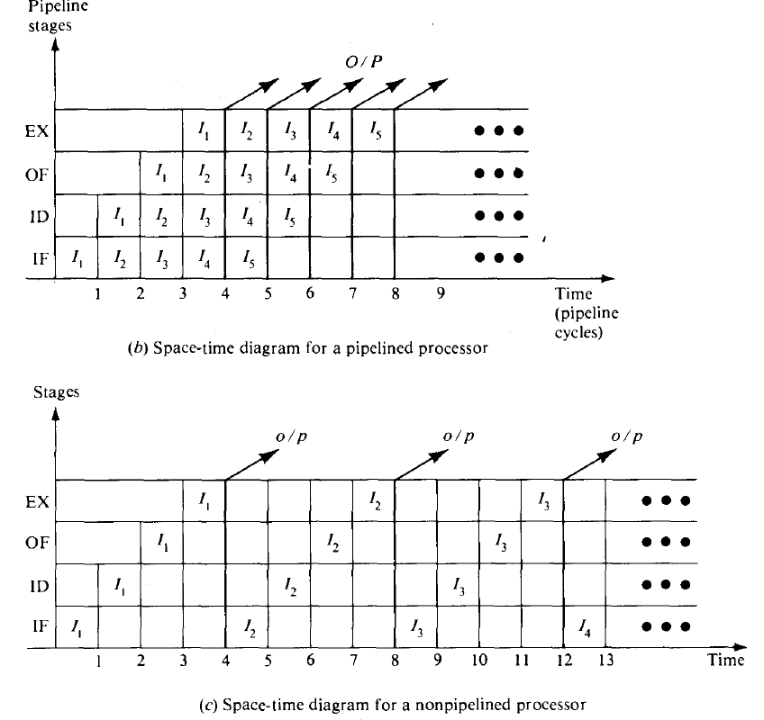


Slide 7
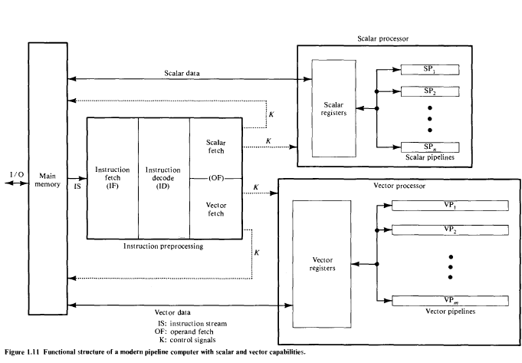

Slide 8
2. Array Processors
An array processor is a synchronous parallel computer with multiple arithmetic logic units called processing elements (PE) that can operate in parallel in lock step.
The PEs is synchronized to perform the same function at the same time.
Scalar and control type of instructions are directly executed in the control unit (CU).
Each PE consists of an ALU registers and a local memory.

Slide 9
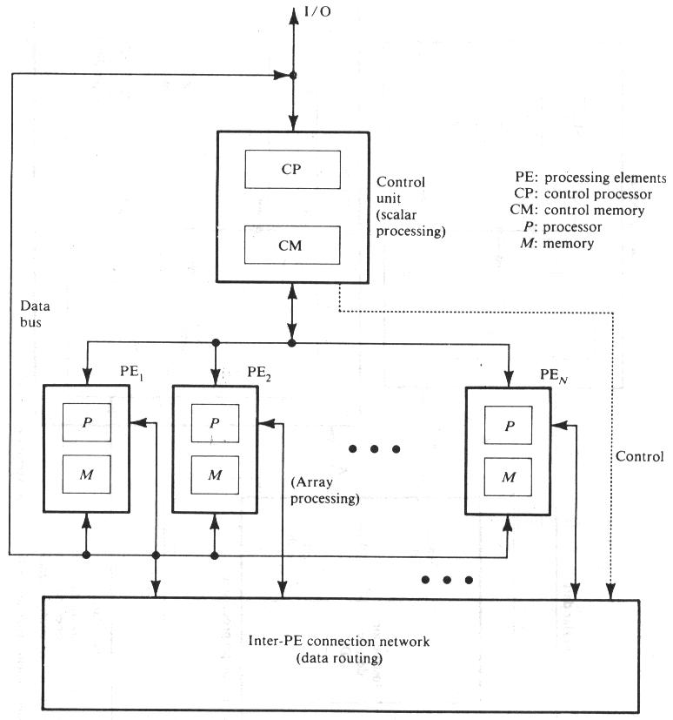
Functional Structure of SIMD array processor with concurrent processing in the control unit

Slide 10
The PEs is interconnected by a data routing network.
Vector instructions are broadcasted to the PEs for distributed execution over different component operands fetched directly from local memories.
Array processors designed with associative memories are called as associative processors.

Slide 11
3. Multiprocessor Systems
A basic multiprocessor contains two or more processors of comparable capabilities.
All processors share access to common sets of memory modules, I/O channels and peripheral devices.
The entire system must be controlled by a single integrated operating system providing interactions between processors and their programs at various levels.

Slide 12
Multiprocessor hardware system organization is determined by the interconnection structure to be used between the memories and processors.
Three different interconnection are
  Time shared Common bus
  Cross Bar switch network
  Multiport memories

Slide 13
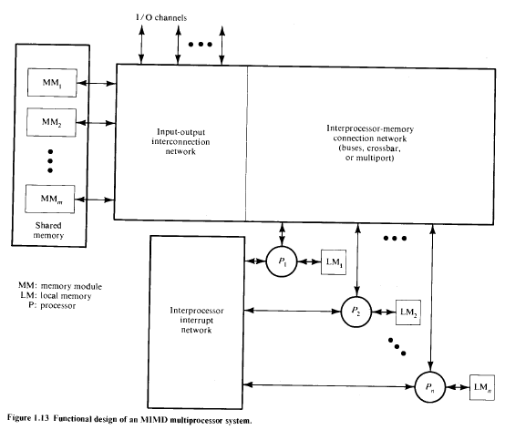

Slide 14
Dataflow Computers
Data flow computers are based on the concept of data-driven computation, which is drastically different from the operation of a conventional von Neumann ma­chine.
The fundamental difference is that instruction execution in a conventional computer is under program-flow control, whereas that in a data flow compute driven by the data (operand) availability.
VLSI Computational Structures
The rapid invent of very-large-scale-integrated technology has created a new architectural horizon in implementing parallel algorithms directly in hardware.

